Slide 1
Predicting Stock Prices Using Machine Learning Algorithm
Nasir Sarkar

Slide 2
Overview
Trading in the stock market is easier than ever
Anyone with access to a phone or a computer can trade
About 70% of all trades happening in the US are being handled by computerized systems
This project will help traders gain a competitive edge in the market by providing them with entry and exit signals

Slide 3
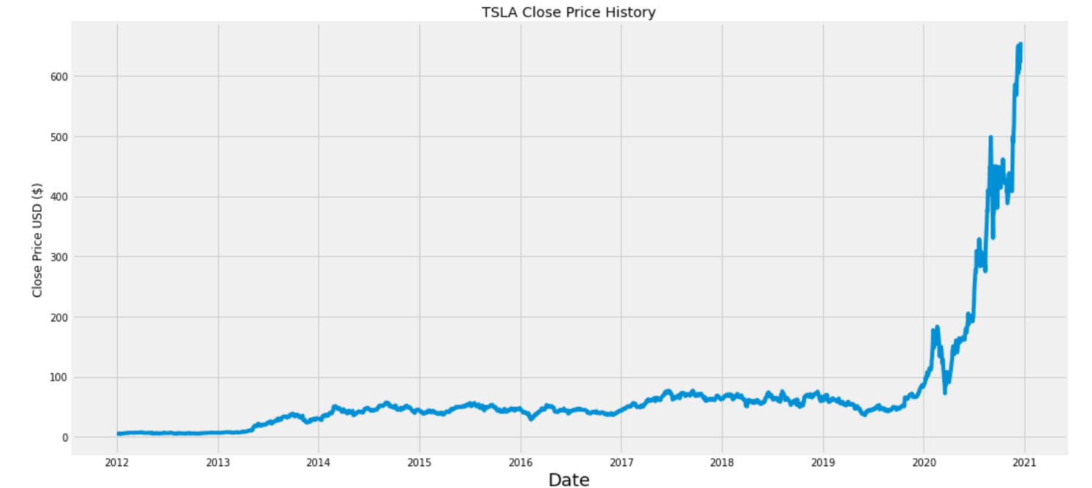
Dataset
The data was retrieved from yahoo finance
There was no need to download the data in the local system

Slide 4
Methodology
Exploratory Analysis
Creating a 30 and a 90 moving average trend lines to find “sweet” spots to buy and sell
Building the LSTM model

Slide 5
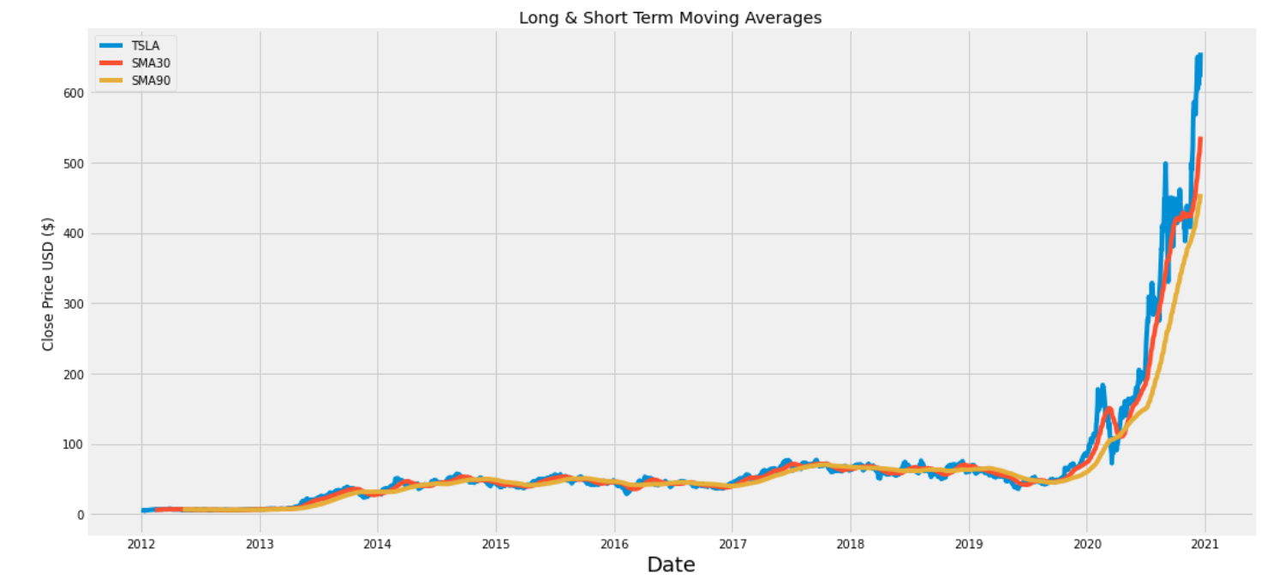
Results
Moving Average Method

Slide 6
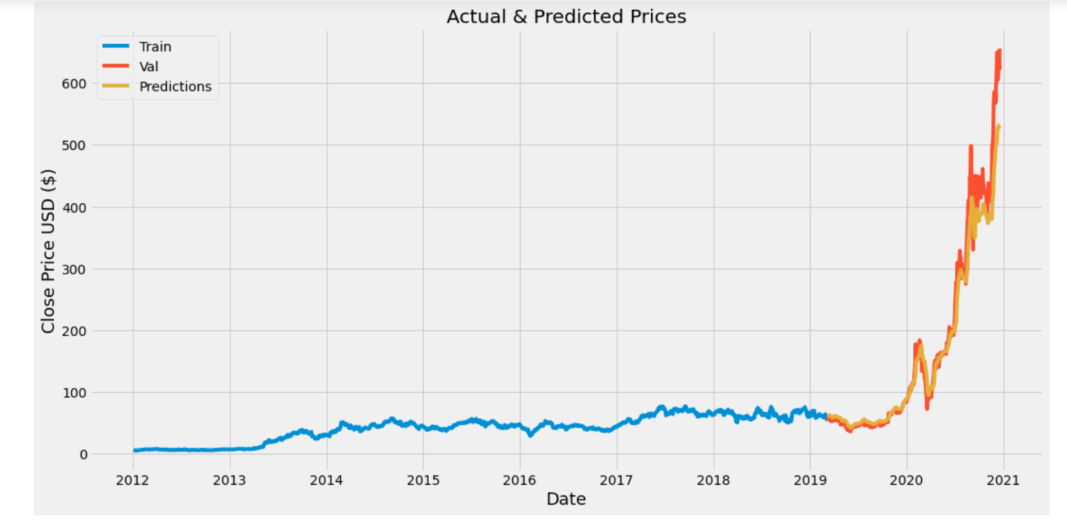
Results
LSTM Model

Slide 7
Results
Root Mean Square Error (RMSE)
RMSE tells you how close the data is to the actual results
In RMSE, a value of 0 is perfect score.
My RMSE score is 10.31.

Slide 8
Challenges
Choosing from different data sources
Making a Github repository & Youtube video for the first time
Building and running the machine learning model

